Slide 1
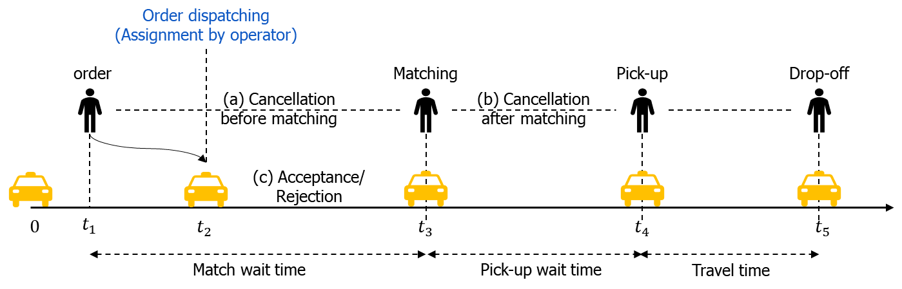
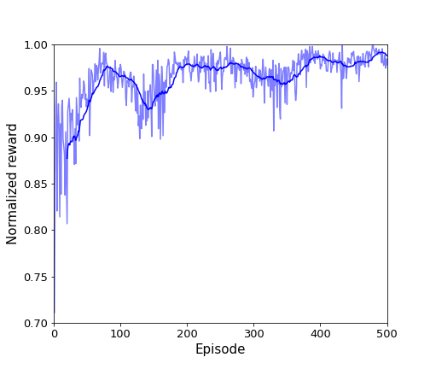
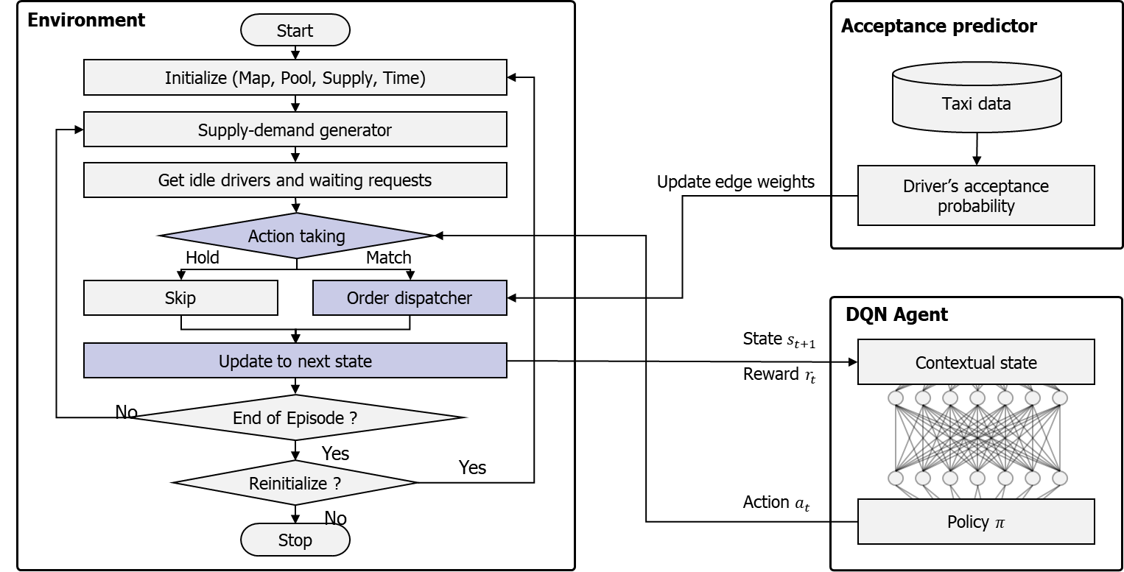
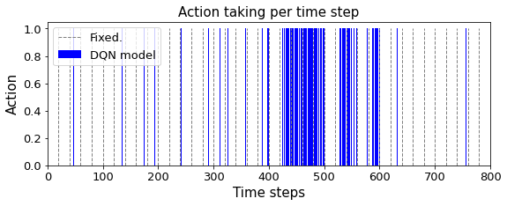
Development of the integrated order dispatching strategy based on combinatorial optimization and reinforcement learning Researcher: Yonggeun Shin
What is the problem?
Supply and demand imbalance problem due to the dynamic and spatio-temporal characteristics in the ride-sharing market
Most studies assume that the driver must accept the assigned order and do not consider the passenger’s cancellation after matching.
They also focus on how to pair request and driver in the current time step, and the potential benefit of the next time step is not considered.
Why is this problem important?
Order dispatching process includes assignments by the operator and unpredictable patterns of passenger (cancellation) and driver (acceptance/rejection) behavior.
Trade-off between longer time intervals to find the optimal combination; passengers wait for longer (even cancel orders).
Even the optimal fixed time interval is difficult to handle dynamic supply-demand patterns.
How can we solve this problem?
Learning driver's acceptance probability based on prediction model and formulating a combinatorial optimization problem to maximize the success rate
We focus on determining the adaptive time interval to find the trade-off between the success rate and the wait time using reinforcement learning
Order dispatching framework
Normalized reward
Action probability
What is key contribution?
formulating a combinatorial optimization problem to maximize the success rate based on driver's acceptance probability
Determining adaptive dynamic time intervals using reinforcement learning
Extensive experiments with simulators based on the Real-world dataset of the Singapore TADA service

